Slide 1
CSE110
Programming Language I

Slide 2
My Brief Profile
Nahian Salsabil (NNS)
Lecturer, CSE, BRACU
BSc: CSE, BUET, 2023
Email: Email: nahian.salsabil@bracu.ac.bd
Room No. UB80601
Consultation Hour:
Sunday: 11:00am - 1:30pm
Monday: 9:30am - 10:50am
Wednesday: 9:30am - 10:50am

Slide 3
Links
Resources: http://tiny.cc/cse110_resources_NNS
Slide: http://tiny.cc/cse110w2_NNS
Slack: http://tiny.cc/cse110_slack

Slide 4
Topics Covered so far
Variables
Variables Naming Convention
Data Types
print()
Keywords
Declaring Variables
Deleting Variables
Operators

Slide 5
Outline
Operators
Operator Precedence
Type Conversion
Input()
Branching

Slide 6
Operators
Unary
Unary Plus
Unary Minus
Binary
Assignment (=)
Addition (+)
Subtraction (-)
Multiplication (*)
Division (/)
Floor Division (//)
Modulus (%)
Exponential (**)

Slide 7
Floor Division
print(10.5//2.5) ⇒ 4.0
print(-5//2) ⇒ -3
print(10.5//2) ⇒ 4.0
print(30//4) ⇒ 7

Slide 8


Modulus
print(-5%2)
print(-5.5%2)
print(5%-2)

Slide 9
Exponential
print(2**4) ⇒ 16
print(-3**2) ⇒ -9
print((-3)**2) ⇒ 9
print(4**-2) ⇒ 1/16

Slide 10
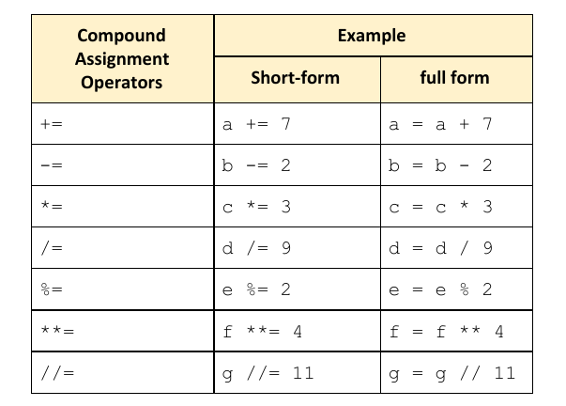
Assignment Operators

Slide 11
Logical Operators
and (logical AND)
or (logical OR)
not (Logical NOT)

Slide 12
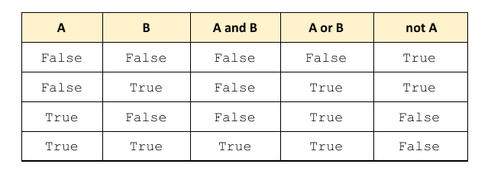
Logical Operator

Slide 13
Logical Operator

Slide 14
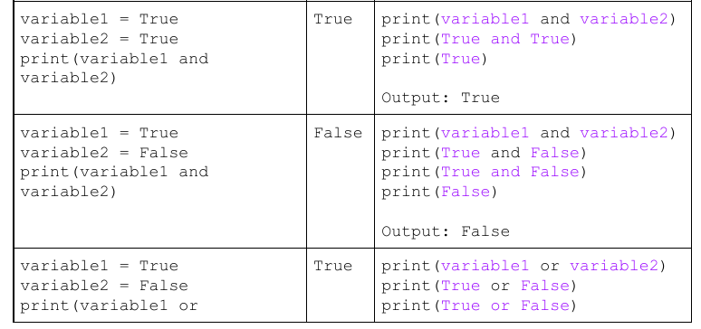
Example

Slide 15
Comparison or Relational Operators
== (equal)
!= (not equal)
> (greater than)
< (less than)
>= (greater than or equal)
<= (less than or equal)

Slide 16
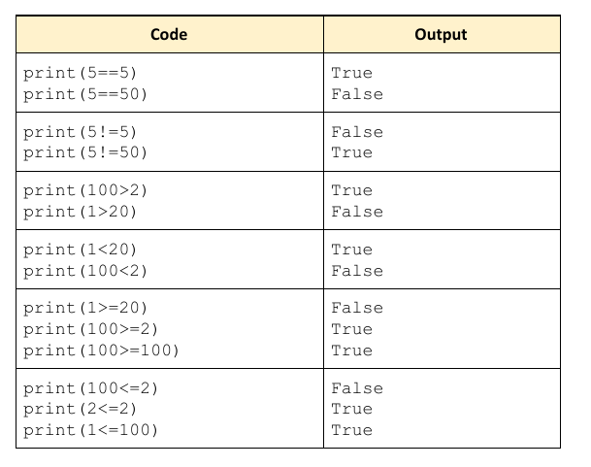
Comparison or Relational Operator

Slide 17
Comparison or Relational Operator

Slide 18
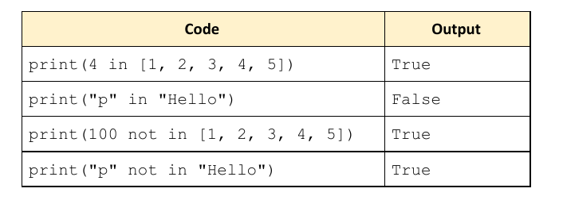
Membership Operators
In
Not in

Slide 19
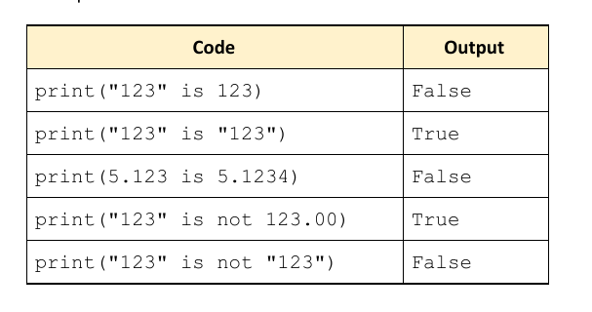
Identity Operators
Is
Is not

Slide 20
Operator Precedence in Compound Expression
()
**
+​x​, -​x
*, /, %, //
+, -
<, <=, >, >=, <> (Not Equal), !=, ==
AND
OR

Slide 21
Associativity
Applicable when operators are in same level
From left to right
print (2+5*4%2-1) ⇒ 1
For exponential, right to left
print(x**y**z) ⇒ ((2**2)**3 = 64
(2²)³ = 64
Notes:
Extra Content but important, so must address at class

Slide 22
Exercise
print(True or False and True)
print((True or False) and True)
print(9 - 5 // 2 * 13 + 2 ** 2)
print(1.5 * 10 // 2 + 8)
print(-3 ** 2 * 2.0)
print(-3 ** ( 2 * 2.0))
print (x – ((x+y%2) *3)//2)

Slide 23
Type Conversion in Python (aka Casting)
int(): constructs an integer number from an integer literal, a float literal or a string literal
float(): constructs a float number from an integer literal, a float literal or a string literal
str(): constructs a string from a wide variety of data types, including strings, integer literals and float literals

Slide 24
Type Conversion in Python (aka Casting) continued
Explicit Type Conversion
x = int(1) # x is now 1
y = int(2.8) # y is now 2
z = int(“3.1”) # z is now 3
x = float(1) # x is now 1.0
y = float(2.8) # y is now 2.8
z = float(“3.1”) # z is now 3.1
x = str(5.5) # x is now “5.5”

Slide 25
Type Conversion in Python (aka Casting) continued
Implicit Type Conversion
x = 1
print(type(x))
x = x + 2.5
print(type(x))
Output:
<class ‘int’>
<class ‘float’>

Slide 26
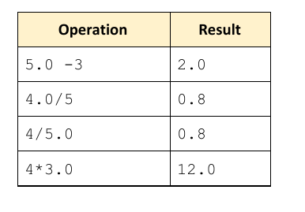
Type Conversion in Python (aka Casting) continued
Implicit Type Conversion

Slide 27
User Input: input() function
The simplest way to take input from the user is
input(‘prompt’)
input() pauses program execution to allow the user to type in a line of input from the keyboard. Once the user presses the Enter Key, all the characters typed are read and and returned as a string.
>>> s = input()
I like Python!
>>> print(s)
Output:
I like Python!
>>> name = input(‘Enter your name: ’)
Enter your name: Alice
>>>print(name)
Output:
Alice

Slide 28
Limitation of input() function
input() always returns a string. If you want a numeric type data, you have to convert the string to appropriate type using int(), float() functions.
>>> n = input(‘Enter a number = ‘)
Enter a number = 50
>>> print(n + 50)
Output:
Traceback (most recent call last):
File "<stdin>", line 1, in <module>
TypeError: can only concatenate str (not "int") to str

Slide 29
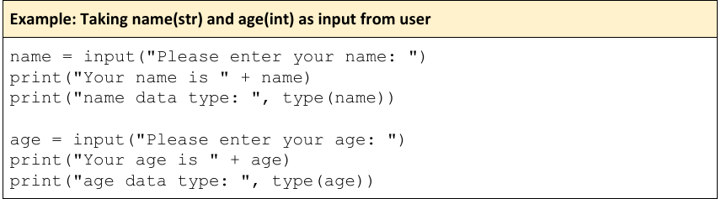
Exercise

Slide 30
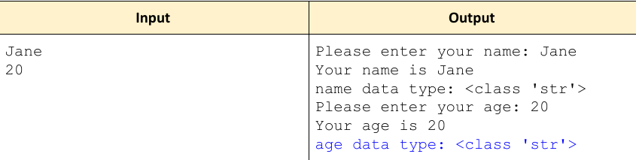

Slide 31
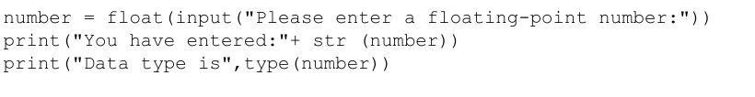
Exercise

Slide 32



Slide 33
Branching
Boolean Expression
compare two values or statements

Slide 34
Boolean Expression
a >= b
(a % 2) == 1
(a >= 60) or (a < 80)
(a >= b) and (a >= c)

Slide 35
Indentation
leading whitespace (spaces and tabs) at the beginning of a particular line of code.
A particular section or bundle of code is called “block”.

Slide 36
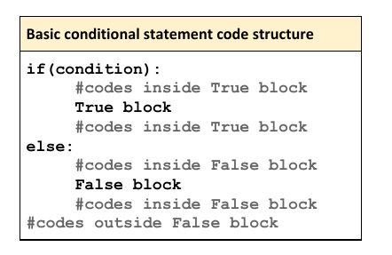
Indentation

Slide 37
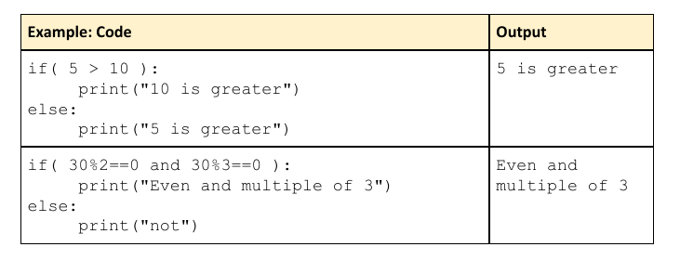
Example

Slide 38
Example

Slide 39
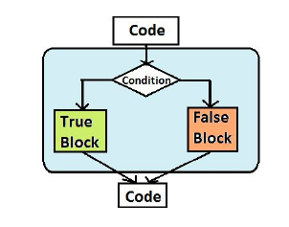
Conditional Statement

Slide 40
Conditional Statements
if
if - else
if - elif - else

Slide 41
if statement
The condition must be a
boolean expression. It must
evaluate to either true or false.
Syntax of the if statement
: (colon) must be given after condition
if is a Python reserved word
if condition:
statement
A tab key ( )
must be inserted before the statement
(aka indentation).
If the condition is true, the statement is executed.
If it is false, the statement is skipped.
There may be multiple lines of statement.

Slide 42
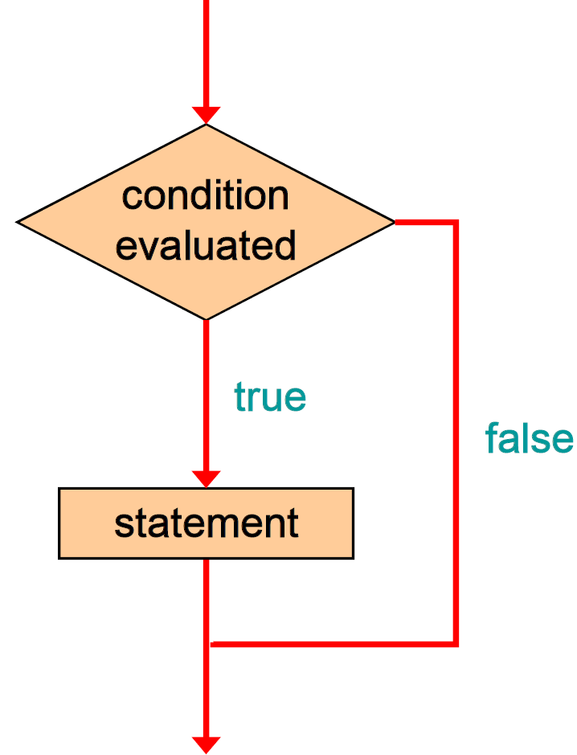
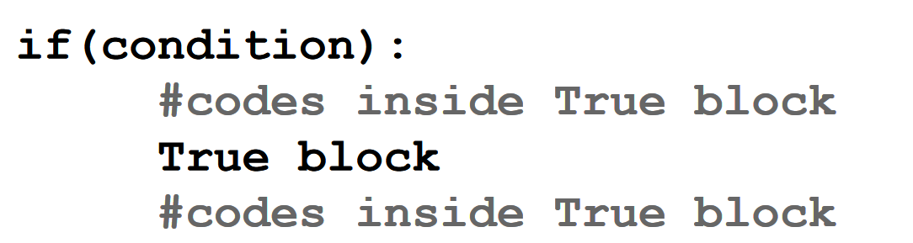
if statement
Logic of an if statement

Slide 43
if-else statement
An else clause can be added to an if statement to create it an if-else statement
If the condition is true, statement1 is executed.
If the condition is false, statement2 is executed.
Either statement1 or statement2 will be executed, but never both.
if condition:
statement1
else:
statement2

Slide 44
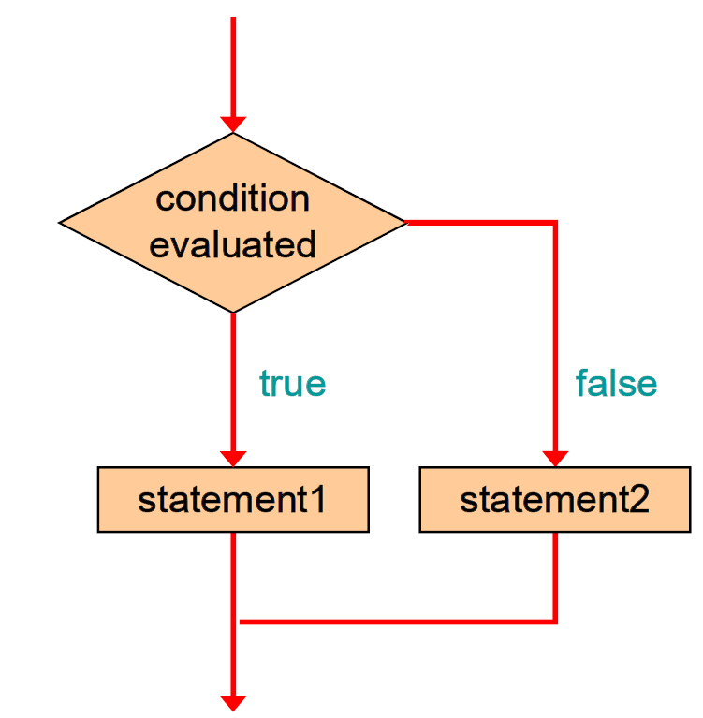
if-else statement
Logic of an if-else statement
if condition:
statement1
else:
statement2

Slide 45
if-else statement: An Example
marks = input(‘Enter your marks = ‘)
marks = int(marks)
if marks > 40:
print(“You have passed!”)
else:
print(“You have failed!”)

Slide 46
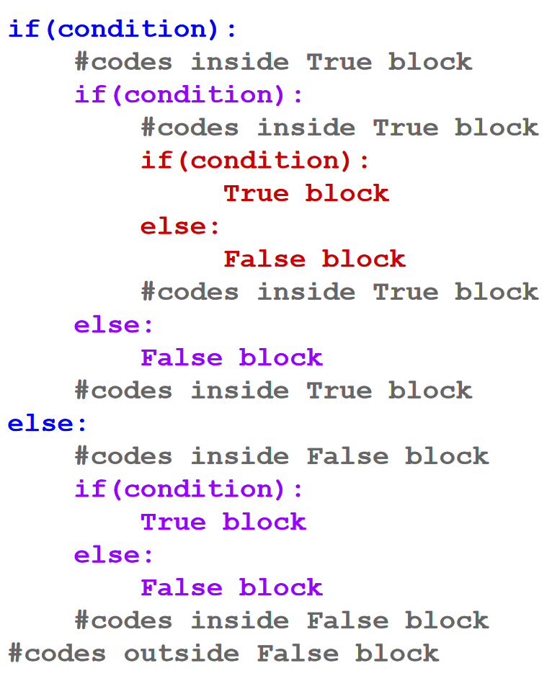
Nested Statements
The statement of an if-else block itself could be another if block or another if-else block.
Using an if or an if-else statement inside another if or if-else block is called nesting
if condition:
statement1
else:
statement2

Slide 47
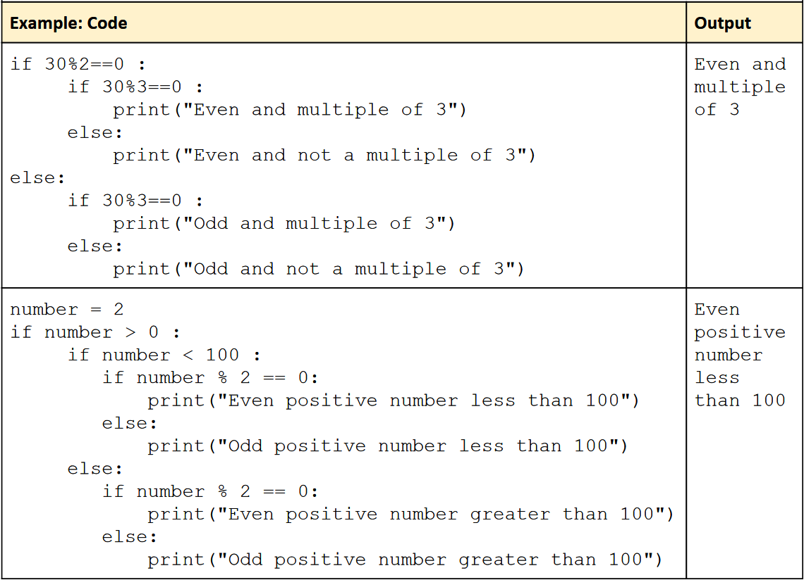
Nested Statements: Example

Slide 48
Practice
Write a program that will take two numbers as input, and then print the larger number.

Slide 49
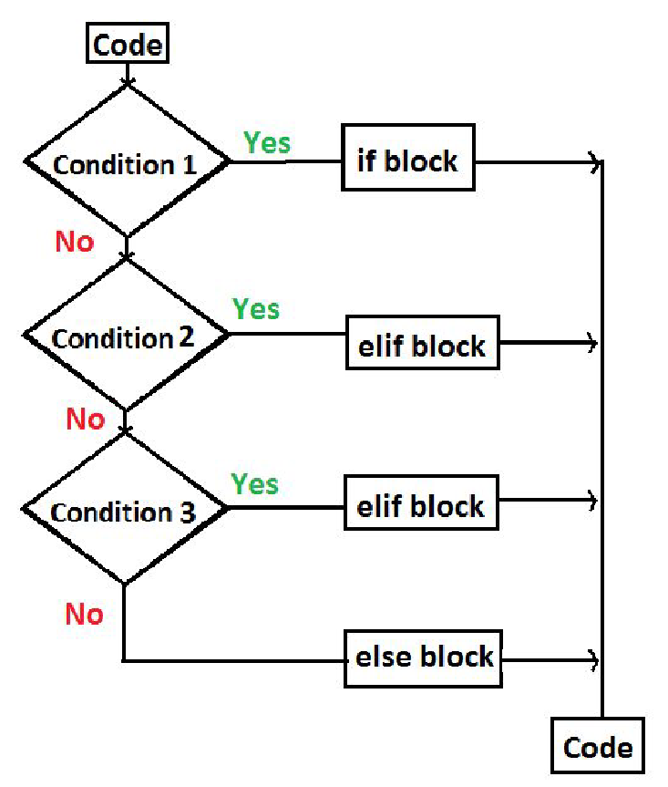
if-elif-else or chained or ladder statement

Slide 50
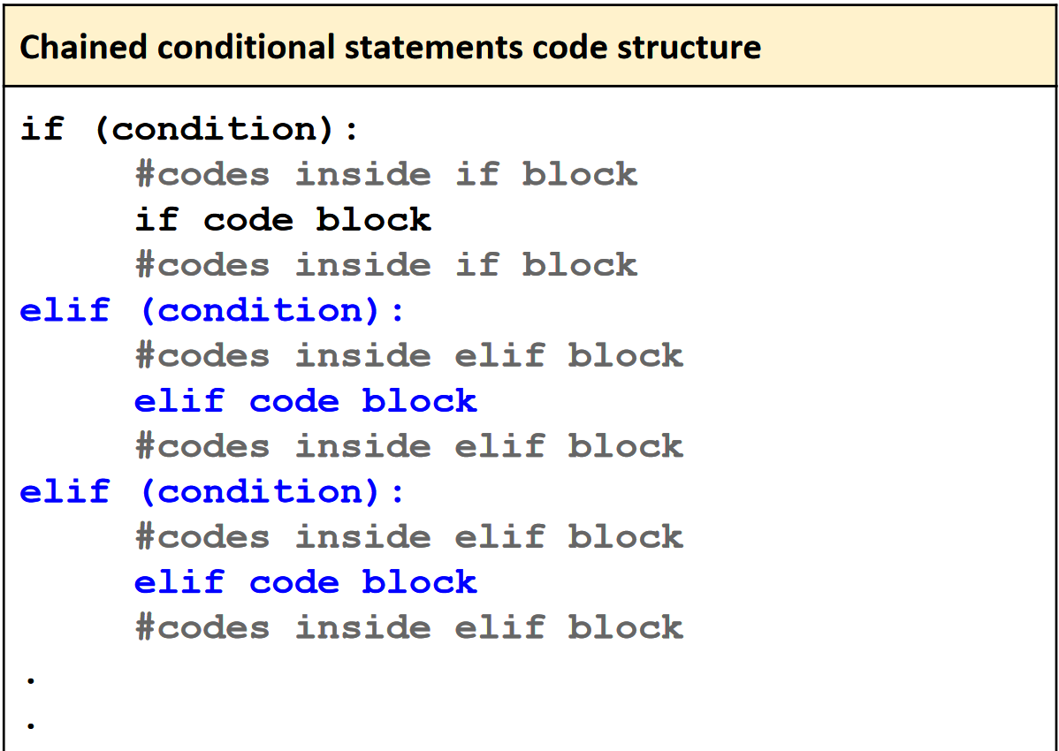
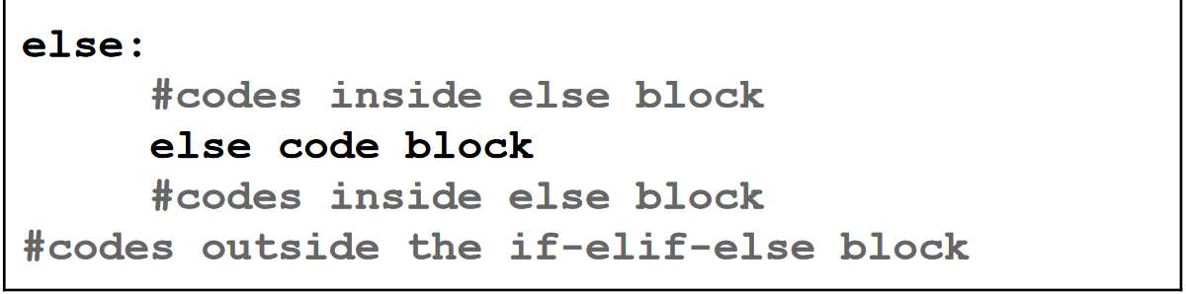
if-elif-else or chained or ladder statement

Slide 51
Practice
Write a program that will take three numbers as input, and then print the largest number.
Write a program that will take three numbers as input, and then print the second largest number.

Slide 52
Practice
Write a program that will take a student’s mark (integer between 0 and 100) as input and print the letter grade according to the following table:
90-100 | A+
80-89 | A
70-79 | B
60-69 | C
50-59 | D
40-49 | E
<40 | F

Slide 53
Practice
Write a program that will take an year as input and print whether that year is a leap year or not.

Slide 54
Leap year problem: solution using if-elif-else
if year % 400 == 0:
print(“Leap year”)
elif year % 100 == 0:
print(“Not a leap year”)
elif year % 4 == 0:
print(“Leap year”)
else:
print(“Not a leap year”)

Slide 55
Leap year problem: solution using if-else
if (year % 400 == 0) or ((year % 4 == 0) and (year % 100 != 0)):
print(“Leap year”)
else:
print(“Not a leap year”)

